Slide 1
NLP: Word Embedding Tutorial
Word2Vec
Skip-GRAM vs CBOW
Reza Marzban

Slide 2
Natural Language Processing (NLP)
NLP is a subfield of Artificial Intelligence.
Its roots goes back to 1950 (Alan Turing).
NLP enables machines to communicate with user in human languages.
Unlike other fields, the data is consisted of words instead of numbers.

Slide 3
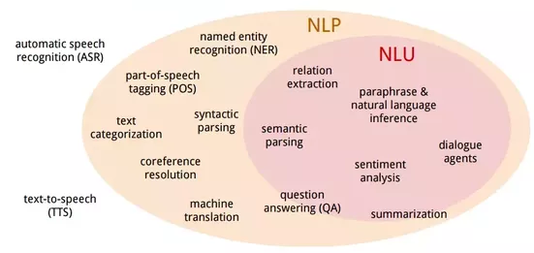
Natural Language Processing (NLP)

Slide 4
Relation of NLP and Big Data
NLP helps leverage information contained in unstructured big data better.
It is estimated that in near future, all the big data analysis will be performed using NLP, as data size will exceed 44 trillion GB worldwide so the scope of NLP for Big Data Analytics will only grow.
NLP can help in the following areas:
Human Interactions: Siri, Alexa, …
Business Intelligence: Tracking a certain social media hashtags and keywords that cover the topic.
Sentiment analysis: Analyzing Customer feedback

Slide 5
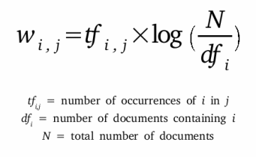
Using Text in Machine Learning models
We need to extract features from textual data.
Traditionally TF-IDF was used to represent textual data.
The i^{th} Word in the j^{th} Document representation could be calculated by:

Slide 6
Representing words as numbers
There are several ways to represent words in numerical format:
One hot encoding: Creating dummy variables for each and every unique words.
N-gram representation: includes unigram, bigram, trigram, …
Word2Vec: proposed by Mikolov in 2013*
* Mikolov, Tomas, et al. "Distributed representations of words and phrases and their compositionality." Advances in neural information processing systems. 2013.

Slide 7
One Hot Encoding
If in our entire corpus we have 3 unique words: [Big, Data, Analytics]
Their one-hot encoding would look like this:
Big: [1,0,0]
Data: [0,1,0]
Analytics: [0,0,1]
In real life scenarios, the number of unique words is huge.

Slide 8
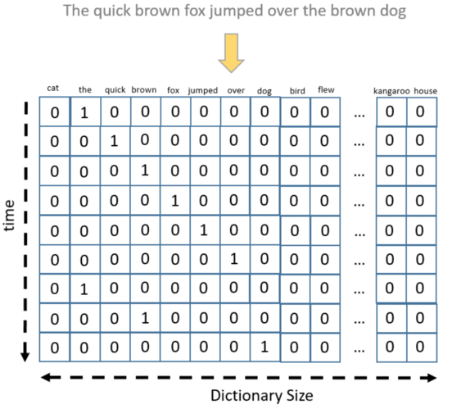
One Hot Encoding

Slide 9
One hot Encoding challenges
It will create a very large sparse matrix for large corpus. If we have just 100 text, with 2,000 total unique words, we will end up with a [100*2,000] sparse matrix (Curse of Dimensionality).
There is no semantic mechanism in this technique:
similarity(Big, Data) does not mean anything.

Slide 10
N-Gram
n-gram is a contiguous sequence of n items from a given sample of text or speech.
The n-grams typically are collected from a text or speech corpus. When the items are words, n-grams may also be called shingles.
It was covered earlier in the course.

Slide 11
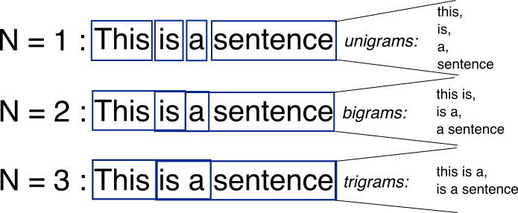
N-Gram

Slide 12
Word2Vec
Word2Vec uses a neural network to learn word associations from a large corpus.
It trains in an unsupervised manner.
It will learn the semantic of each word, and also the relation of them with other words.
As the name implies, Word2Vec represents each distinct word with a particular list of numbers called a Word Embedding.

Slide 13
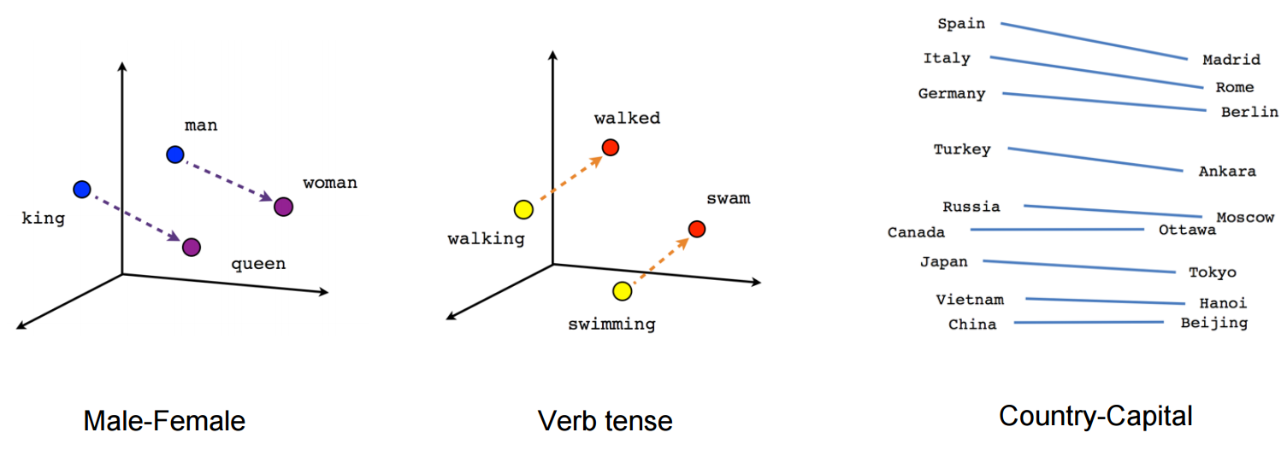
Word Embedding
The word embedding, which is trained on a large corpus, can understand the relations between words.

Slide 14

Word Embedding
The word embedding is just a vector with a custom length (a hyper-parameter).
Using this vector, we can extract words relations:
$$king −man+woman≈queen$$
$$Spain −Germany+Berlin≈Madrid$$

Slide 15
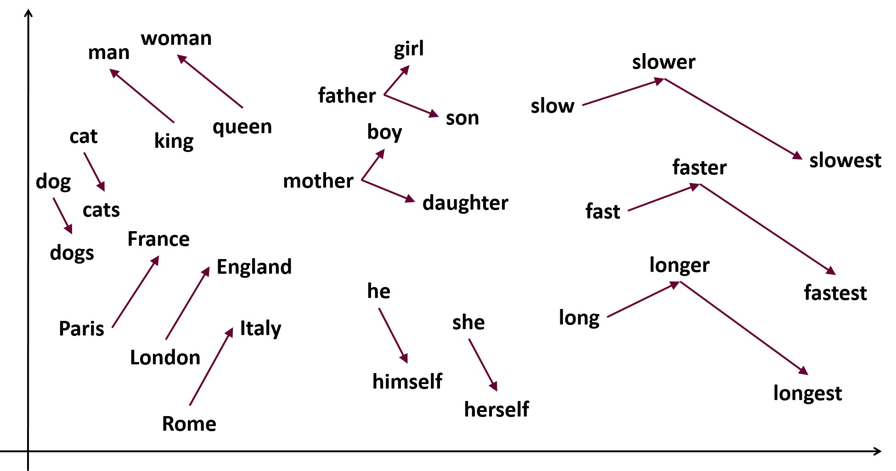
Word Embedding (size of 2)

Slide 16
Word2Vec training
For training word embedding with Word2Vec on a large corpus, we can use one of two following algorithms:
Skip-Gram
CBOW
Both are architectures to learn the underlying word representations for each word by using neural networks.

Slide 17
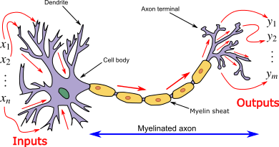
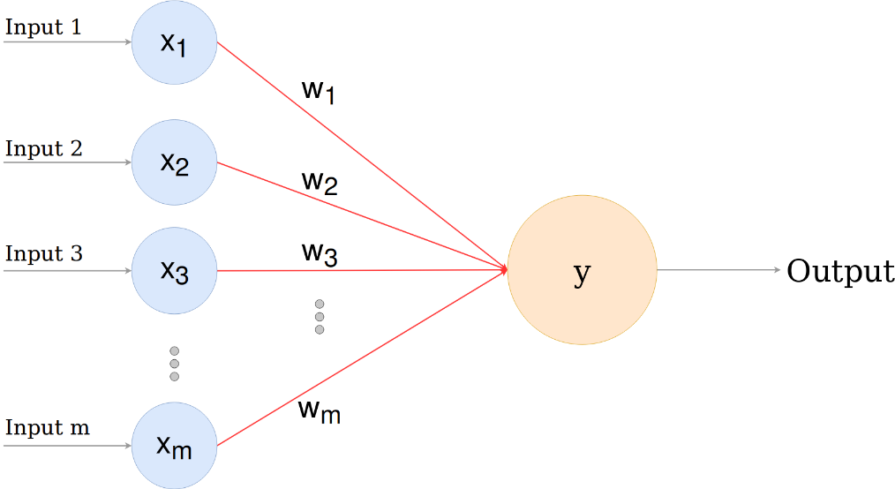
Artificial Neural Networks (ANN) Overview
It is trying to mimic human brain’s neurons.
Each of its nodes is a simple Perceptron.

Slide 18
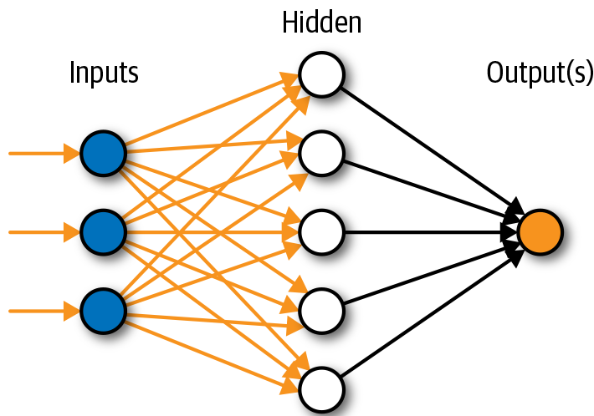
Artificial Neural Networks (ANN) Overview
Each ANN model have several layers, and each layer have several nodes (Perceptron).
This basic architecture of Deep Learning model is called Fully connected model.

Slide 19
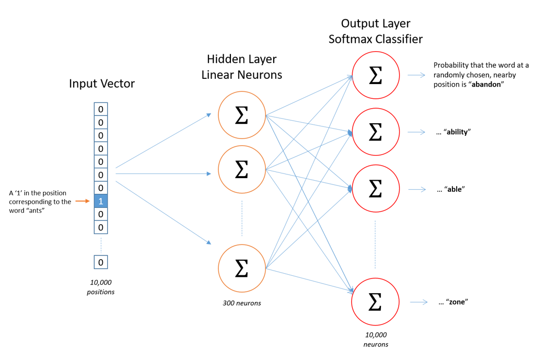
Skip-gram
In skip-gram, we’ll try to predict its neighboring words. We’ll define a neighboring word by the window size.

Slide 20
Skip-gram
The dimensions of the input vector will be 1*V — where V is the number of words in the vocabulary — i.e. one-hot representation of the word.
The single hidden layer will have dimension V*E, where E is the size of the word embedding and is a hyper-parameter.
The output from the hidden layer would be of the dimension 1*E, which we will feed into an softmax layer.

Slide 21
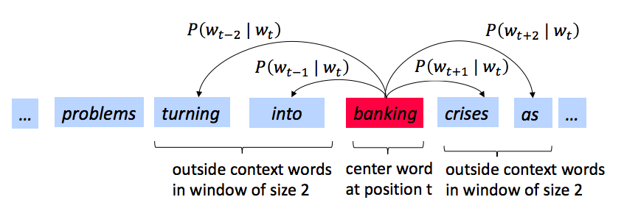
Skip-gram

Slide 22
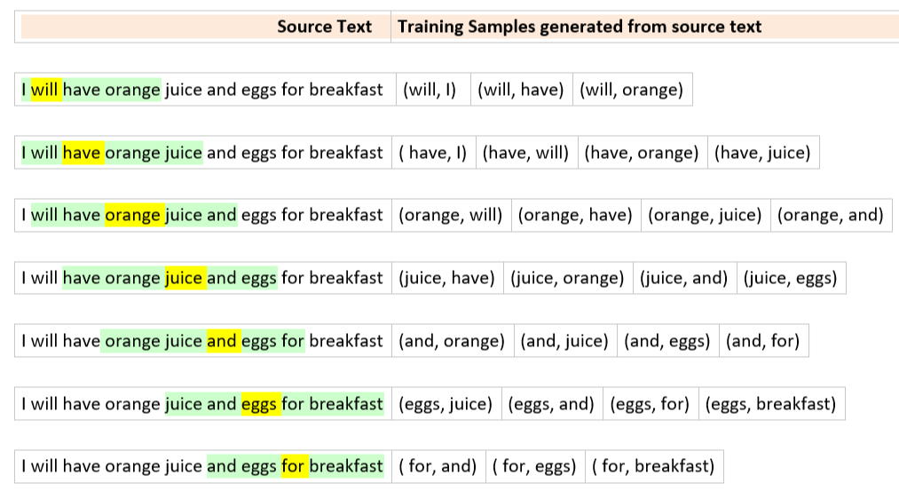
Skip-gram
Given the sentence: “I will have orange juice and eggs for breakfast.” and a window size of 2:

Slide 23
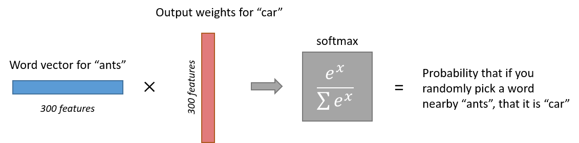
Skip-gram
The probability of occurrence of “car” around “ants” is calculated by:

Slide 24
CBOW
CBOW stands for “Continuous Bag of Words”.
It is very similar to Skip-Gram, instead of trying to predict context based on the word, it will predict the word based on the context.
It also has the window size as the hyper-parameter.
It uses the same architecture of Neural network with a few tweaks.

Slide 25
CBOW
The dimension of our hidden layer and output layer will remain the same.
Only the dimension of our input layer will change.
If we have 4 context words for a single target word, we will have four 1*V input vectors. Each will be multiplied with the V*E hidden layer returning 1*E vectors.

Slide 26
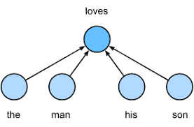
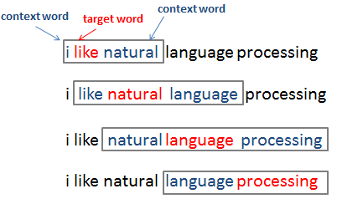
CBOW

Slide 27
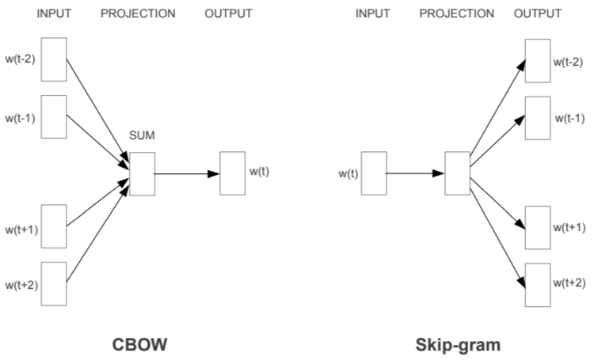
CBOW vs Skip-gram

Slide 28
CBOW vs Skip-gram
Skip-gram: works well with a small amount of the training data, represents well even rare words or phrases.
CBOW: several times faster to train than the skip-gram, slightly better accuracy for the frequent words. (Preferable for Big Data)

Slide 29
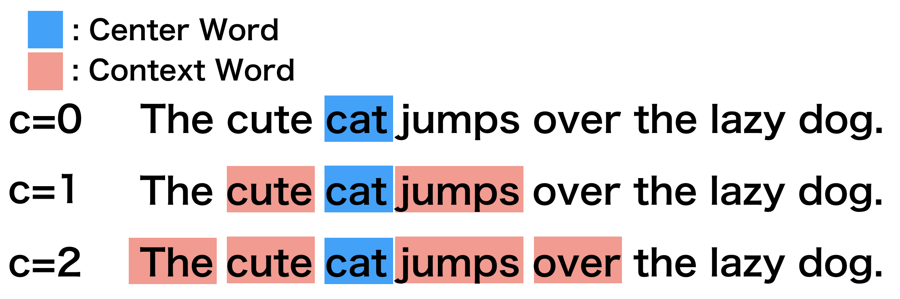
Word2Vec Hyper-Parameters
Window Size (c): The number of words to be considered as the context.

Slide 30
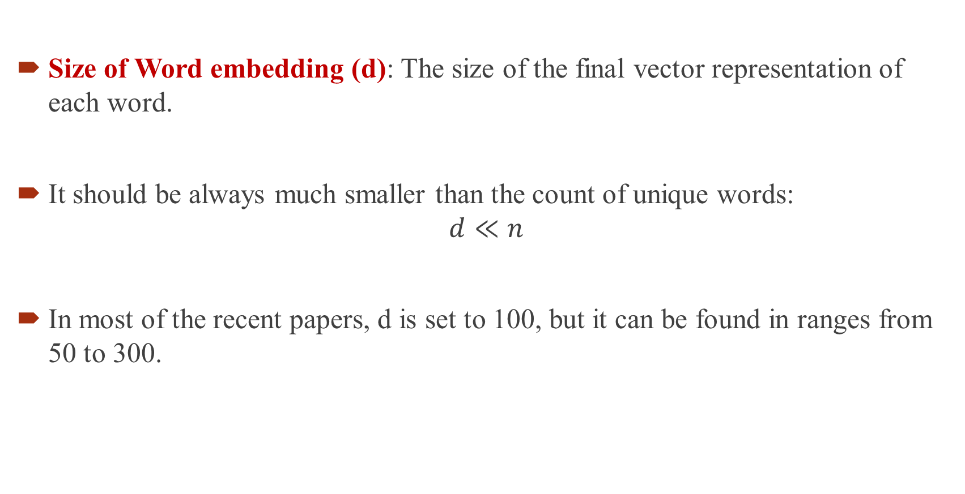
Word2Vec Hyper-Parameters
Size of Word embedding (d): The size of the final vector representation of each word.
It should be always much smaller than the count of unique words:
$$d≪n$$
In most of the recent papers, d is set to 100, but it can be found in ranges from 50 to 300.

Slide 31
Pre-trained Word Embedding (GloVe)
If you have enough data, you can train your word embedding model from scratch, but if your data is limited, you can use one of many publicly available pre-trained word Embedding.
GloVe (Global Vectors for Word Representation)*: offered by Standford, is trained on a huge textual dataset. They provide embedding vectors with various sizes (from 50 to 300).
* Pennington, Jeffrey, Richard Socher, and Christopher D. Manning. "Glove: Global vectors for word representation." Proceedings of the 2014 conference on empirical methods in natural language processing (EMNLP). 2014.

Slide 32
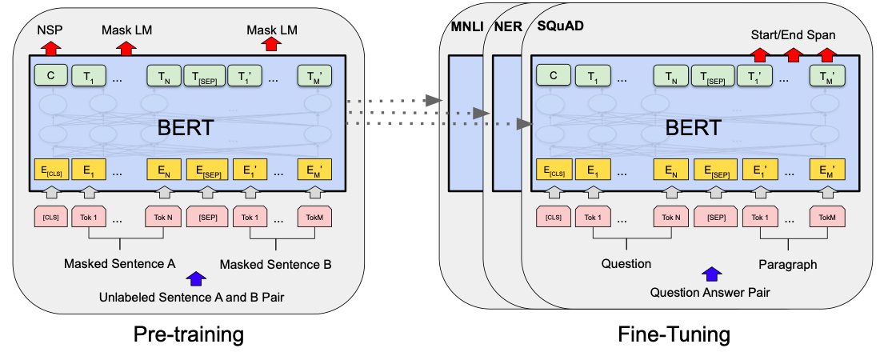
Pre-trained Word Embedding (BERT)
Created by Google AI team.
BERT Pre-Train on Wikipedia and can be fine-tuned on any NLP tasks.
It is built on Transformers blocks and attention mechanism.
* Devlin, Jacob, et al. "Bert: Pre-training of deep bidirectional transformers for language understanding." arXiv preprint arXiv:1810.04805 (2018).

Slide 33
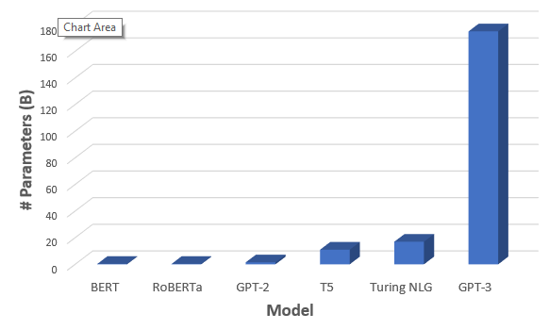
Pre-trained Word Embedding (GPT3)
Created by Open AI team.
Very similar to BERT.
Much bigger and more parameters.
* Brown, Tom B., et al. "Language models are few-shot learners." arXiv preprint arXiv:2005.14165 (2020).

